Slide 1
Lect – 17, 18
DATA LINK LAYER
(Elementary Datalink Protocols)

Slide 2
What is Data Link Layer ?
The data link layer is Layer 2 in the Open Systems Interconnection (OSI) architecture model for a set of telecommunication protocols.
The data link layer is the protocol layer in a program that handles the moving of data into and out of a physical link in a network.
It is responsible for the node-to - node delivery of data and frame are used in it . Its major role is to ensure error-free transmission of information. DLL is also responsible to encode, decode and organize the outgoing and incoming data.

Slide 3
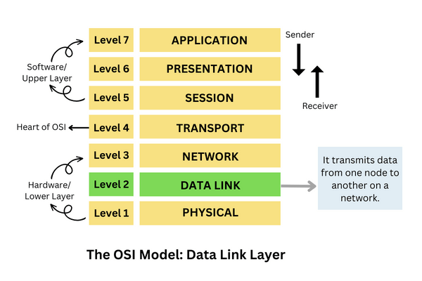
Function of Data link layer.

Slide 4
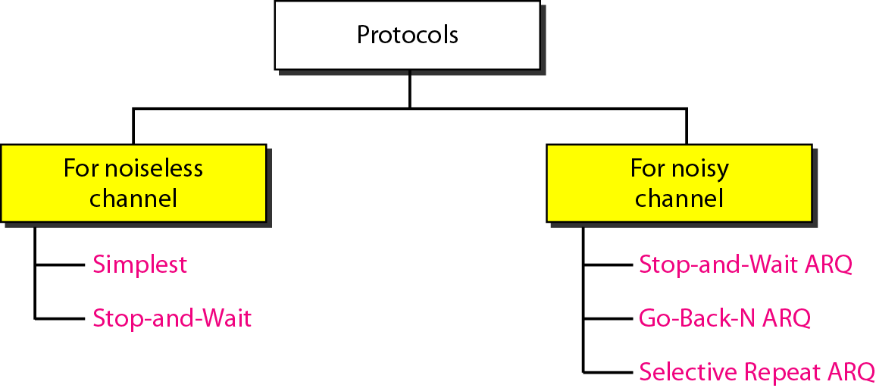
DATA LINK LAYER (Elementary Datalink Protocols)

Slide 5
Noiseless channel – Protocol Types.
Simplest Protocol –
It is a type of protocol in which No flow and Error Control is performed .
The simplest protocol is a unidirectional protocol in which the data frames are traveling in only one direction from the sender to the receiver. Since the simplest protocol is unidirectional, there is no acknowledgment (ACK).

Slide 6
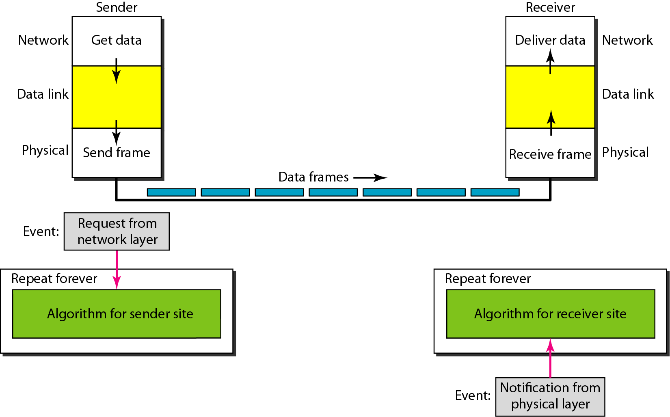
The design of the simplest protocol with no flow or error control.

Slide 7
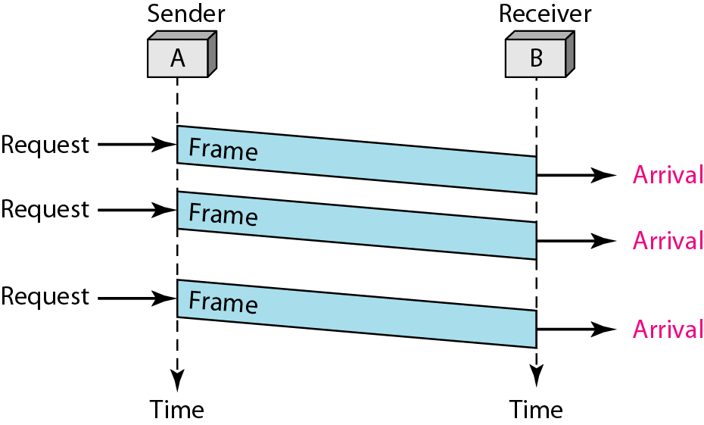
Flow diagram for Simplest .

Slide 8
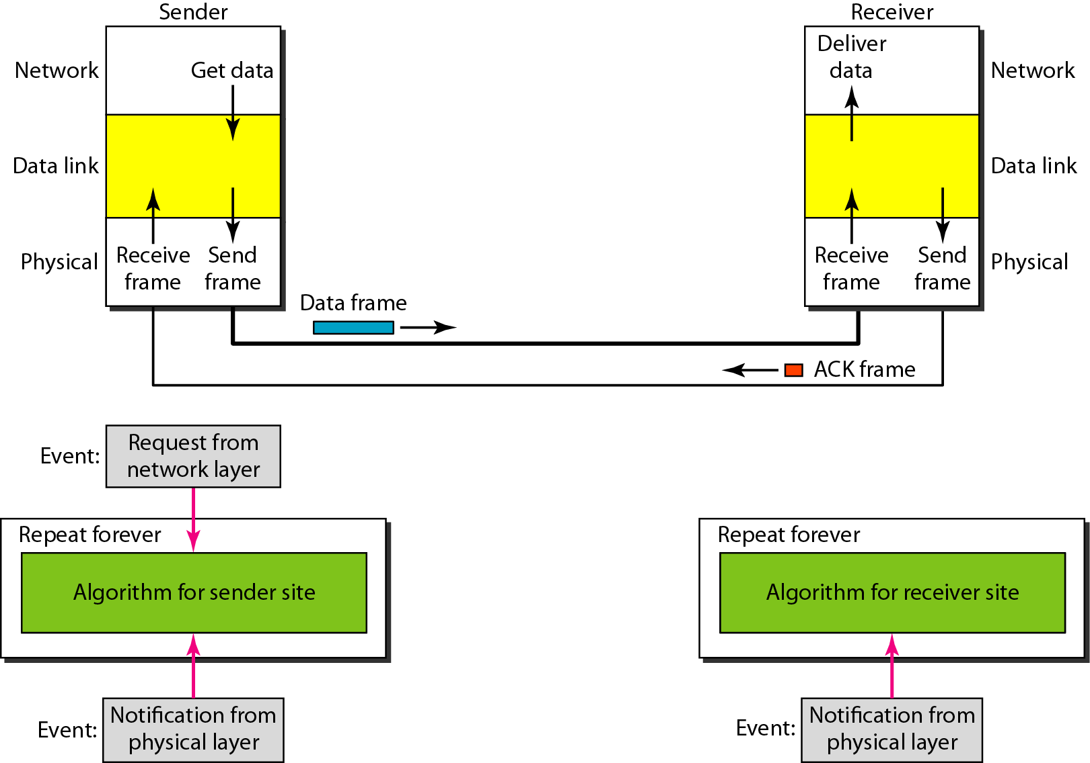
Stop-and-Wait Protocol .
Sender sends one frame, stops until it gets confirmation from receiver.

Slide 9
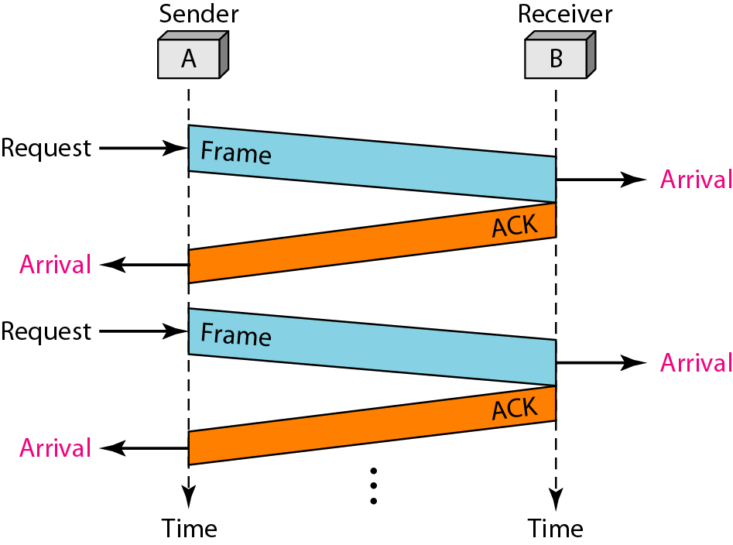
Flow diagram for Stop and Wait .

Slide 10
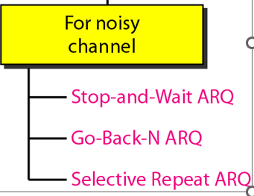
For Noisy Channel Protocols.

Slide 11

Note
In Stop-and-Wait ARQ, the acknowledgment number is 0 if sequence number is 1 and acknowledgment number is 1 if sequence number is 0

Slide 12
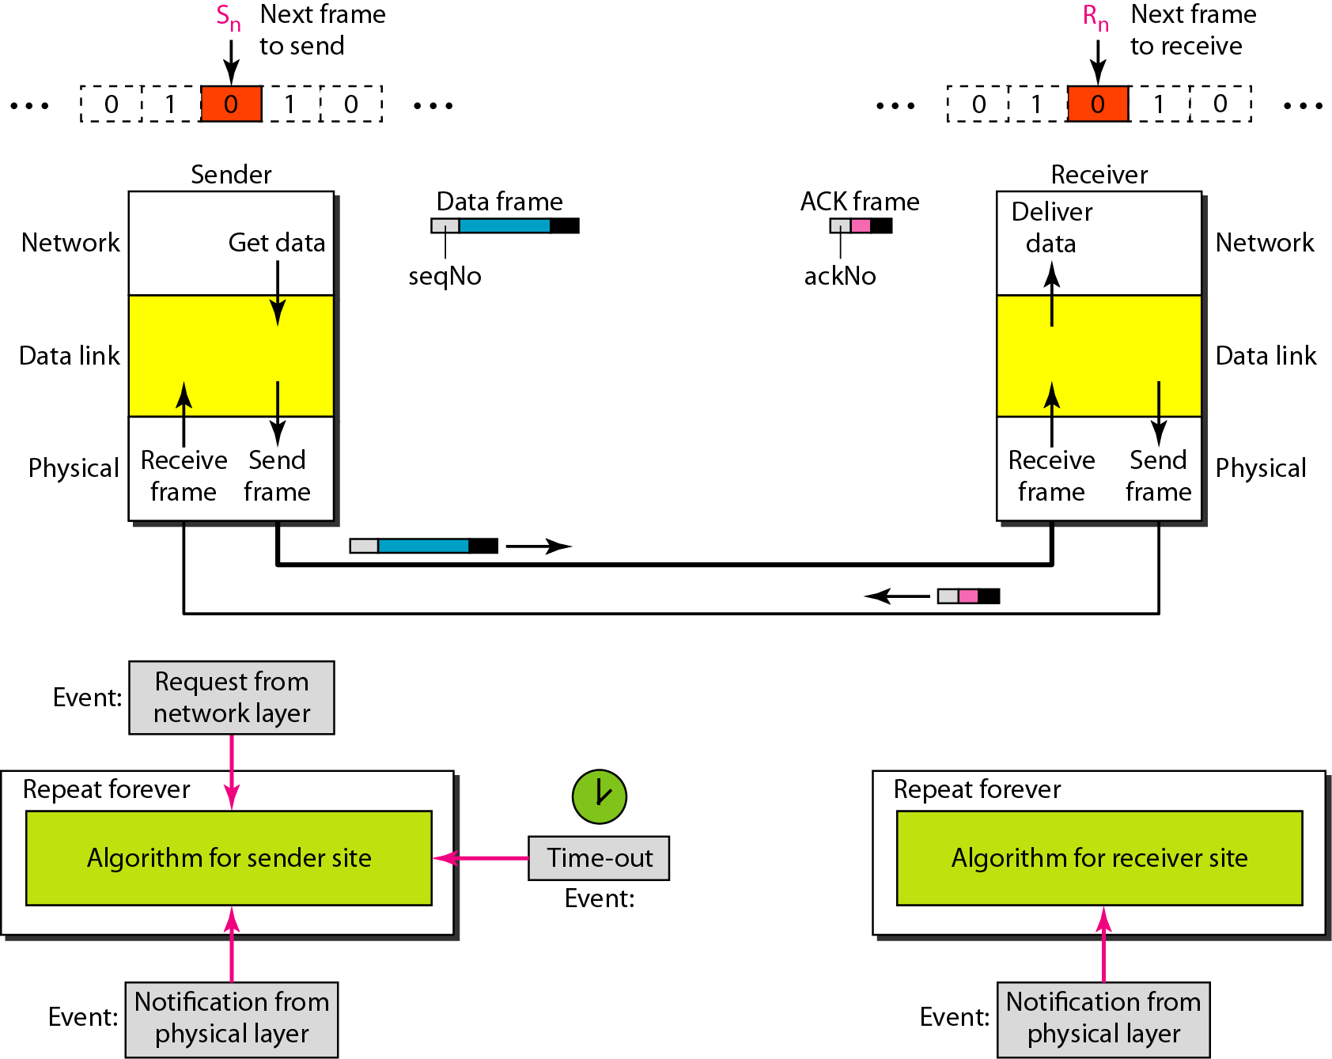

Slide 13
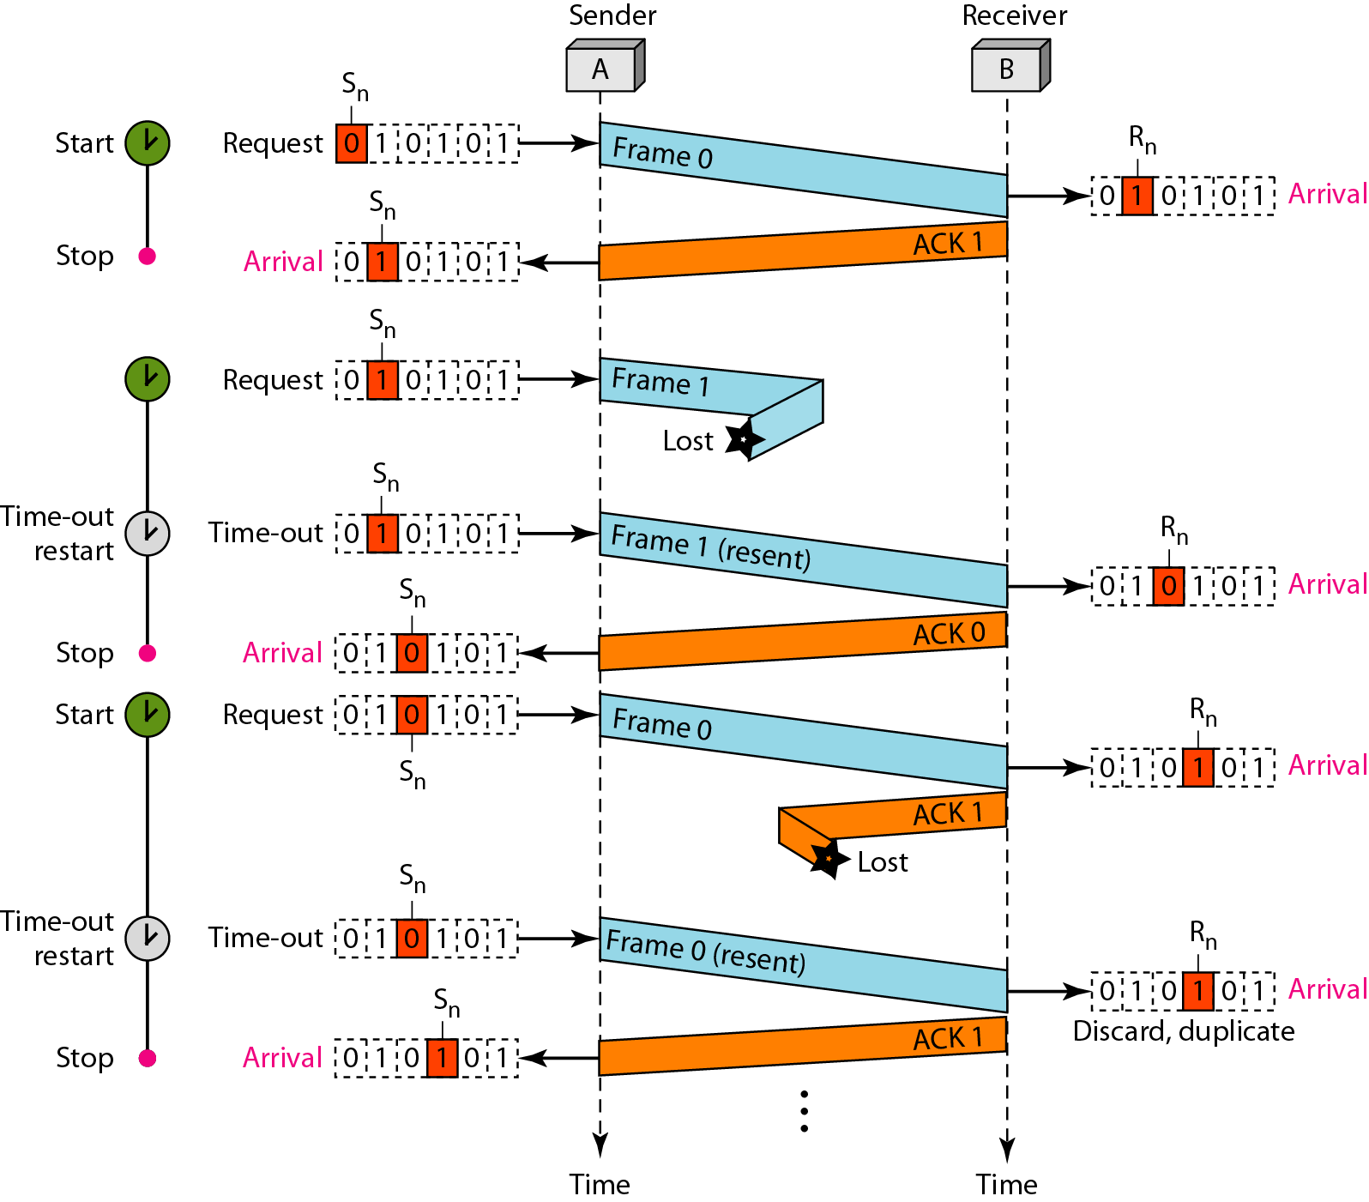

Slide 14
Disadvantage Stop-and-Wait ARQ Protocol.
Inefficient---if channel is thick and long
Thick means high bandwidth
Long means roundtrip delay
Product of both is bandwidth delay.
Bandwidth delay is number of bits we can send while waiting for news from receiver.

Slide 15
What is Go-Back-N ARQ?
In Go-Back-N ARQ, N is the sender's window size. By taking a example , suppose we say that Go-Back-3, which means that the three frames can be sent at a time before expecting the acknowledgment from the receiver.
It is based on the principle of protocol pipelining in which the multiple frames can be sent before receiving the acknowledgment of the first frame. If we have five frames and the concept is Go-Back-3, which means that the three frames can be sent, i.e., frame no 1, frame no 2, frame no 3 can be sent before expecting the acknowledgment of frame no 1.

Slide 16
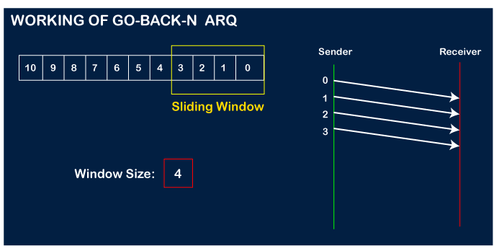
In Go-Back-N ARQ, the frames are numbered sequentially as Go-Back-N ARQ sends the multiple frames at a time that requires the numbering approach to distinguish the frame from another frame, and these numbers are known as the sequential numbers.

Slide 17
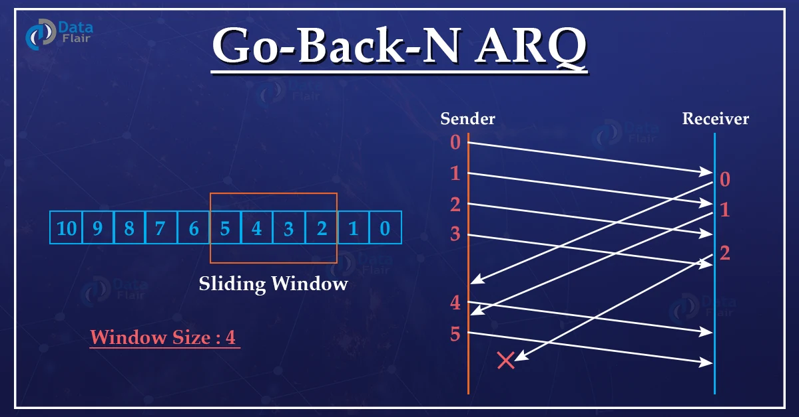
Working example of Go – Back –N –ARQ.

Slide 18
Noisy channel protocol-Selective Repeat ARQ.
It is also known as Sliding Window Protocol and used for error detection and control in the data link layer.
In the selective repeat, the sender sends several frames specified by a window size even without the need to wait for individual acknowledgement from the receiver as in Go-Back-N ARQ. In selective repeat protocol, the retransmitted frame is received out of sequence.
In Selective Repeat ARQ only the lost or error frames are retransmitted, whereas correct frames are received and buffered.
The receiver while keeping track of sequence numbers buffers the frames in memory and sends NACK for only frames which are missing or damaged. The sender will send/retransmit a packet for which NACK is received.

Slide 19
Working of Selective Repeat of ARQ ?
Explanation
Step 1 − Frame 0 sends from sender to receiver and set timer.
Step 2 − Without waiting for acknowledgement from the receiver another frame, Frame1 is sent by sender by setting the timer for it.
Step 3 − In the same way frame2 is also sent to the receiver by setting the timer without waiting for previous acknowledgement.
Step 4 − Whenever sender receives the ACK0 from receiver, within the frame 0 timer then it is closed and sent to the next frame, frame 3.
Step 5 − whenever the sender receives the ACK1 from the receiver, within the frame 1 timer then it is closed and sent to the next frame, frame 4.
Step 6 − If the sender doesn’t receive the ACK2 from the receiver within the time slot, it declares timeout for frame 2 and resends the frame 2 again, because it thought the frame2 may be lost or damaged.

Slide 20
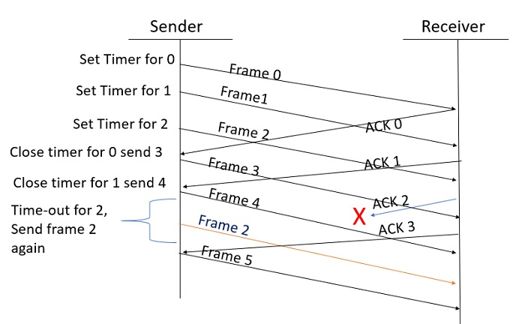
Working procedure of Selective Repeat ARQ.

Slide 21
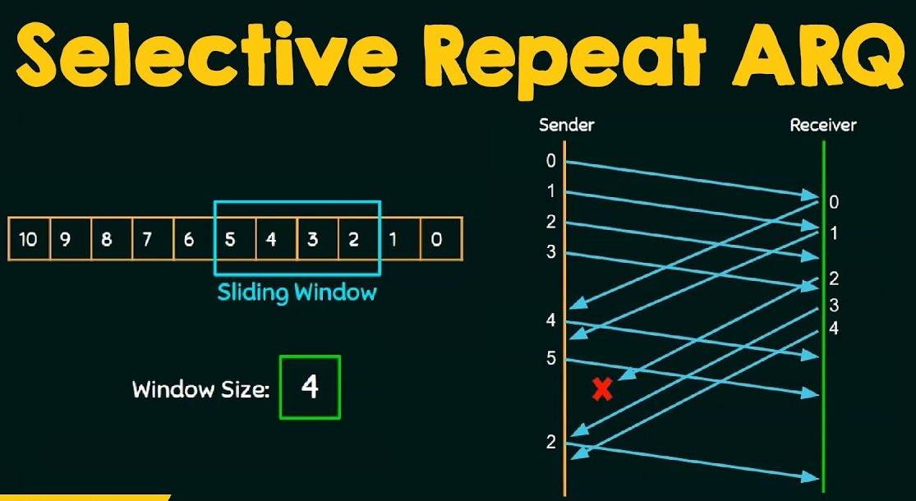

Slide 22


